Slide 1
Data Skills 10 Million
The future speaks data, do you?
What is Data Skills 10 Million? It’s Tableau’s program to fulfill our commitment of enabling 10 million people with data skills over the next 5 years to help close the data literacy gap

Slide 2
What exactly are “data skills”?
Data skills are the individual capabilities that when combined, give people some level of data literacy
Then what is “data literacy”?
Data Literacy is the spectrum of capability that describes an individual’s ability to explore, understand, and communicate with data

Slide 3
Why do data skills matter?
87% of decision-makers rated basic data skills as the most important skill for day-to-day tasks in their departments
Despite the belief in the importance of data skills, only 47% of respondents in the recent Forrester study were offered basic data skills training
Based on a recent study by Forrester of 2,068 people. Link to the study here

Slide 4
What are we doing about it?
We have enabled more than 2.5 million teachers and students across the globe with data skills (since 2011)
We’ll create/have created resources to enable widespread data skills training and education within organizations
We’ll also create educational resources to enable individuals with in-demand data skills
We’ll work internally and with third-party organizations to ensure that this education is available to everyone
Based on a recent study by Forrester of 2,068 people. Link to the study here

Slide 5
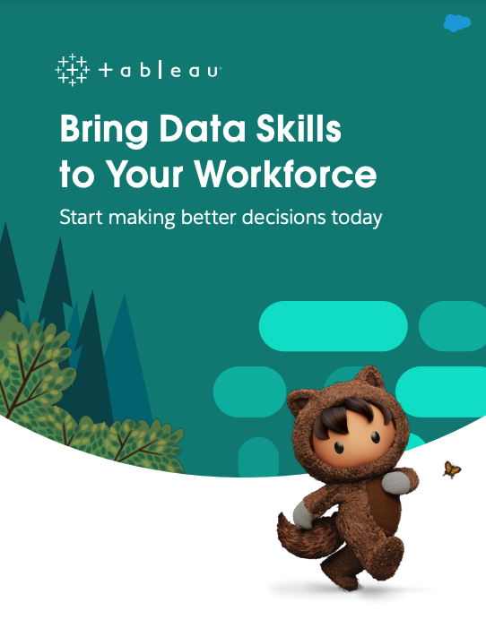
We know enabling an entire organization can seem impossible
To help bring foundational data skills to your org, we’ve created a new and completely free Workforce Education Guide.
The guide has prescriptive resources and plans that help both the person(s) responsible for widespread enablement, and the individuals they are trying to enable

Slide 6
How can an organization benefit from upskilling it’s people?
Increase and accelerate ROI for your analytics platform
Increase analytic platform adoption
Increase employee satisfaction and retention
Help you get to informed answers faster
Enable your users to find useful insights in your data

Slide 7
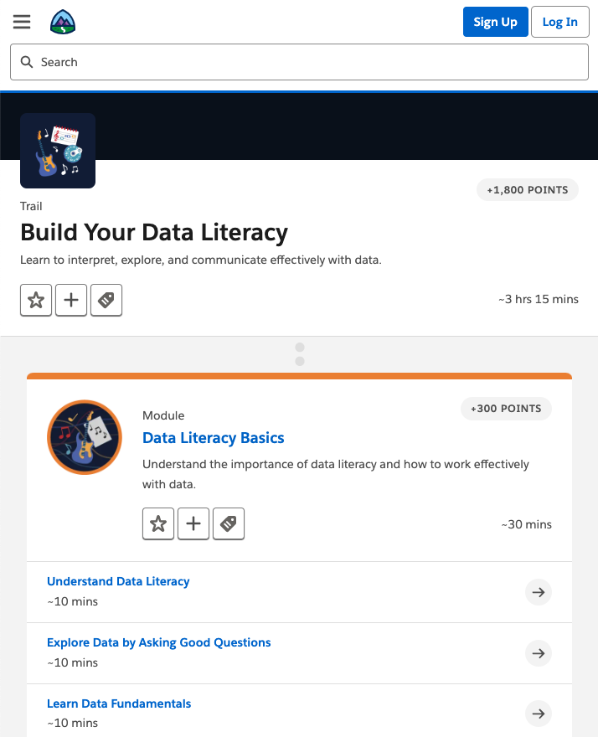
We also know that upskilling yourself can be tough
To help you learn foundational data skills we created a completely free data literacy course called Build Your Data Literacy.
It can be tough to find time to invest in you which is why we made the modules short and easy to digest. You also never know when or where you’ll have time to learn which is why it’s on Trailhead, Salesforce’s free, mobile-friendly training platform so you can learn when it’s convenient for you.

Slide 8
How can individuals benefit from upskilling themselves?
You’ll make better decisions and build your reputation
Increased skills increase your value to an organization
It’ll be easier to find useful insights in your data
You’ll get to informed answers faster
Your new capabilities will elevate you amongst your peers
Increased skills equal increased career opportunities

Slide 9
What should you do now?
If you haven’t already, check out the Workforce Education Guide. Have thoughts or suggestions about the guide? Give us feedback here
Take the Build Your Data Literacy trail! The whole trail takes just over three hours and is broken down into 10 minute modules. Earn a new badge and 1800 points toward your goals on Trailhead
Check out our web page for all that you need to know about Data Skills 10 Million
Interested in learning more about our academic programs? Take a look at our other offerings on our Academic Programs page

Slide 10
Thank You

